Slide 1
.NET FrameWork
Muppidi Ajay Kumar​​

Slide 2

About .net
.NET Framework is a software development framework
It include a library and runtime environment (CLR)
The FCL(Framework Class Library) which provides User interface, database connectivity, web development and more
It has language Interoperability

Slide 3
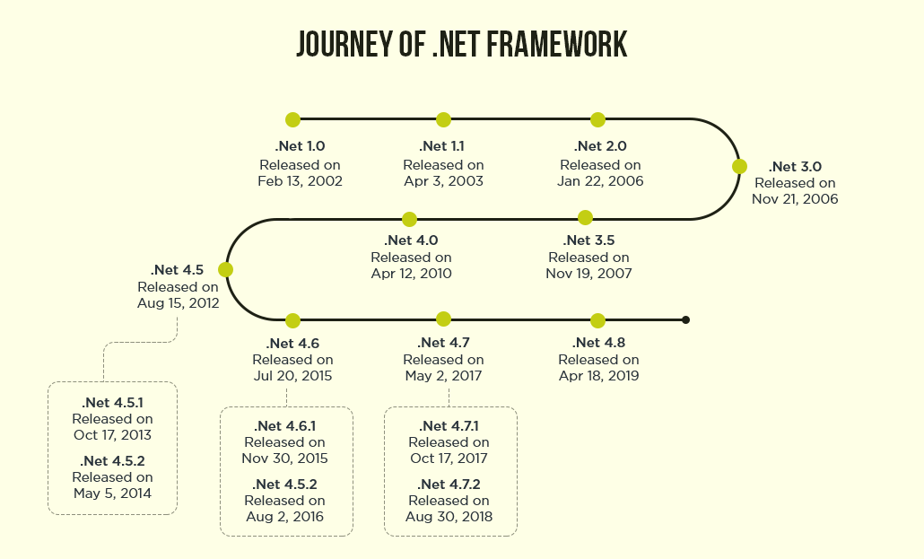
Versions

Slide 4
Advantages
Object-oriented programming​
Language Independence
Code Sharing
Support for services

Slide 5
C# (C Sharp)

Slide 6
About C#(C Sharp)
It is Object-oriented Programming Language
It is Based on C++ and Java, but has many additional extensions
Now C# is on version 8.0
It is simple, Interoperability, scalable, structured programming language
Has Rich Library

Slide 7
Thank you
Muppidi Ajay Kumar
Muppidi.Ajay.Kumar@ibm.com​​

